Slide 1
Blibli Future Projects
Batch 4 - Phase 2

Slide 2
Outlines
Introduction
List of Projects
General Requirements
Brief details
Expectations
Questions?

Slide 3
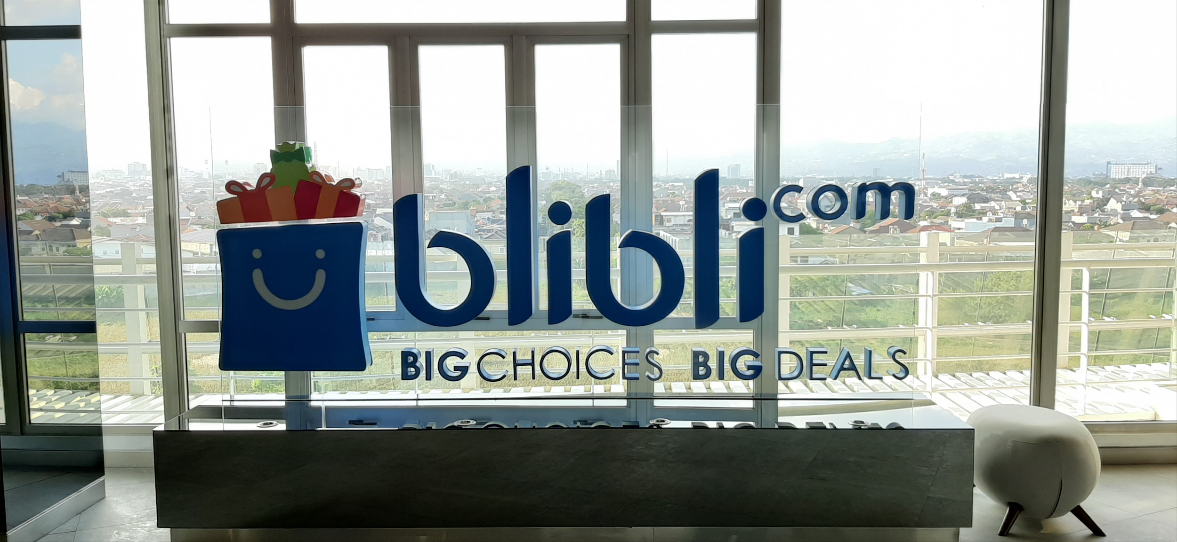
Projects
Indonesia Disaster Crowdsourcing
Mall Map
Visit Danau Toba
Blibli Next Experience
BliMart Digital
Warehouse
Blibli Employee Progress
Food Culinary

Slide 4

Reviews
Best practices
Design Patterns
UI Frameworks
Mock API call in UI
NoSQL DB
Caching Redis
Threads
Reactive Programming
Command Pattern

Slide 5
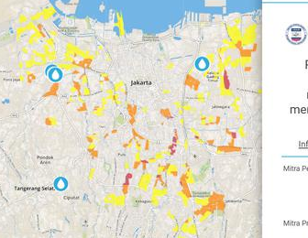
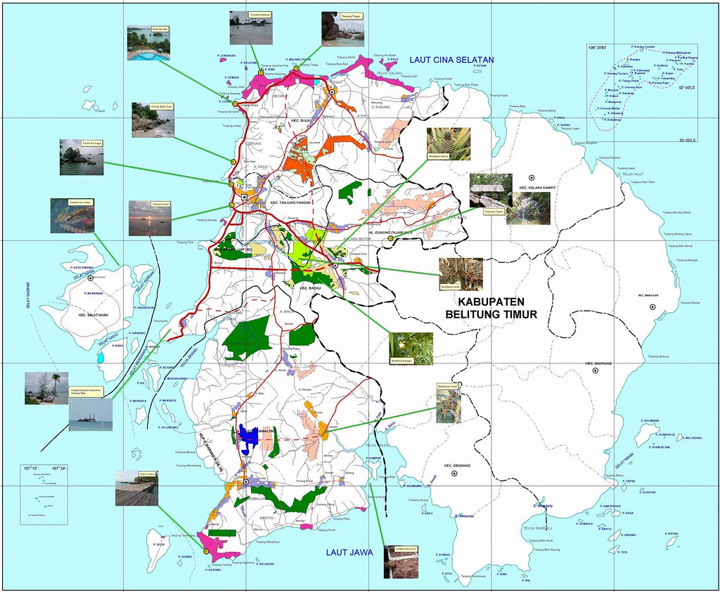
Indonesia Disaster Crowdsourcing
Refer to: https://petabencana.id/
View surrounding disasters
Interaction
Offer helps
Request helps
Funding Coordinators
Pin points
Hot areas
Funding summary and reports

Slide 6
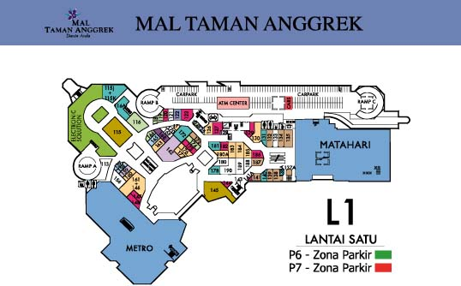
Mall Map
Data entry
Able to draw area or put pin-point to indicate area or point
Check https://wikimapia.org/
Touch screen friendly (imagine large TV)
Path helper
Showing path from current position to targeted point
Directory search (you can use client-side)
Online update

Slide 7

Visit Danau Toba
Information Site
Put anything you can imagine of to attract visitors
E-ticket purchase and generator (add qr-code for validation)
Itinerary builder page and “where to visit around danau toba”
You can drag and drop in calendar-like to generate destination on your several days visit
Search target tourist sites for itinerary (imagine travel*ka experience)
Print or send your itinerary to email / print / pdf
Promo pages / packages sites for bundling e-ticket purchase
Fast and light page
Restaurant Information and reviews
Gallery
Small page to redeem ticket by officers later

Slide 8
Blibli Next Experience
Online shopping is fun again
Scan barcode / qr-code to purchase (any product) and will show up in cart, if not available, show warning
Continue to purchase afterwards
Delivery option provided will be: collect in blimart, delivery
Show blimart locations and searchable (in map)
Generate hidden qr-code for the product image, that we can scan
Merge barcode in the product image
Blibli Barter
Customer can offers items for barters, blibli will be dealing exchange in between
Blibli will validate item as described (confirmation step)
Blibli Inverse Bidding
Customer can put an ads for item, merchants bid for the item

Slide 9
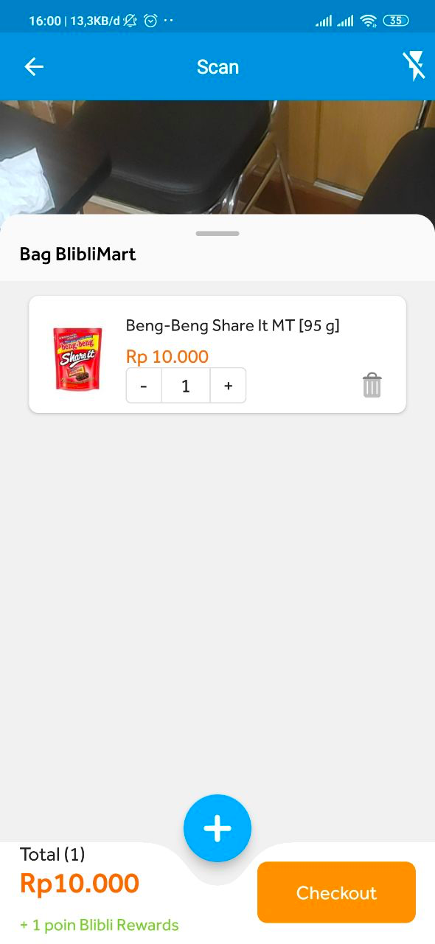


Slide 10
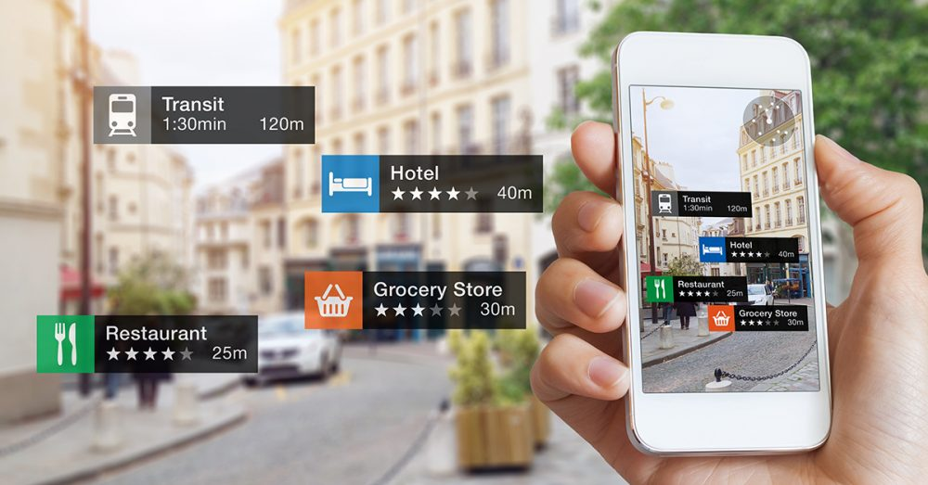
BliMart Digital
Augmented Blimart, showing product location in the shelves and promoted items
Showing path to related item you searched either using augmented reality, or just basic path
Saving item with coordinate in the shelf for the item
Scan to search (barcode / qr-code)
Shop blimart at handphone
Browse with mobile friendly page
Based on blimart location

Slide 11
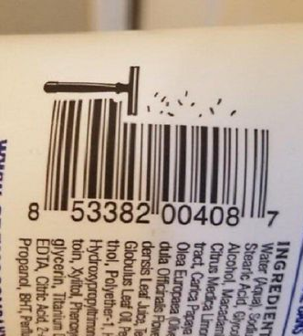
Warehouse
Manage inbound and outbound item
Scan barcode of item to register input/output
Input map of warehouse and product location (slots, racks, levels, floors)
Path finder from gate to targeted items
Best path generator (getting item in best orders) in one take
Queue management for orders
Packaging steps + scan to confirm each steps

Slide 12
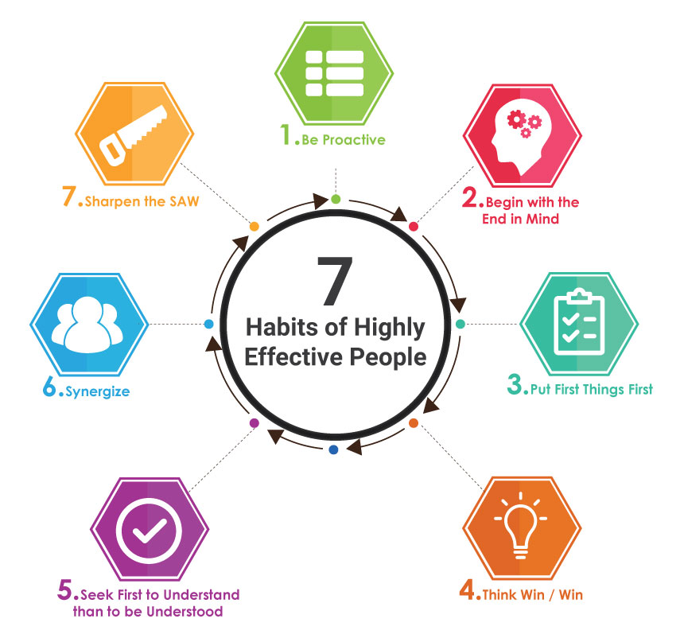
Blibli Employee Progress
Focus on regular training for newcomers
Detect holidays
Employee
Have stages of training from 1-7
Apply the next training and select schedule
Notification if haven’t apply at least once a month
Scan an attendance qr code to confirm attendance
Work on quiz to confirm understandings
Admin
Entry training and regular schedule
Publish announcement
Input training materials and trainer
Input quiz

Slide 13

Food Culinary
Itinerary builder
Search restaurant
Add to timeline
Post photo and review (articles)
Link to instagram and facebook
Vote and like other people posts
Show in timeline (see Path)
Suggest new restaurants (register new one)
Browse by location
Using phone location and any drop point
Promote restaurant (anyone can promote using credit)
Offers vouchers by merchants
Order online to registered merchant (check upnormal)
Share bill (to email/text)

Slide 14
Requirements
Use GIT for work tracking
You can use github.com or gitlab.com
Upload non-code related document in docs folder
We see the progress and contribution, not date-liner
Create mockup first
To prevent implementation misunderstanding, report to mentor for finished mockup
You can use https://zeplin.io/, https://www.invisionapp.com/, https://moqups.com/, or other mockup tools
Should be made before starting project to see how far you understand the requirements
SPA, APIs Spec and Unit Testing (more than 90% coverage)

Slide 15
Suggestions
Map using openstreetmap (OSM)
Location based search (proximity) can use geo filter in various DB, such as postgres and elasticsearch
All mobile first
All web-based
All SPA
All with Vue
Augmented usign AR.js

Slide 16
Expectations
Proses, tidak hanya hasil akhir
Inisiatif untuk belajar
Keaktifan berdiskusi dengan mentor
Tanggung jawab terhadap pekerjaan

Slide 17
Suggested Work order
Create UI Mockup (required)
Push to GIT – private one
Define APIs Spec
Create design documents (put as many as needed as helpers)
Implement UI and API parallel
Push to GIT regularly
Ask your mentor for any issues or just a little chit-chat

Slide 18
Timeline
Development phases
UI Mockups and other reqs (1 month)
Development
Deploy to server
3-4 bulan
Communicate well your works, so it will advance well.
Do not expect others to start first.

Slide 19
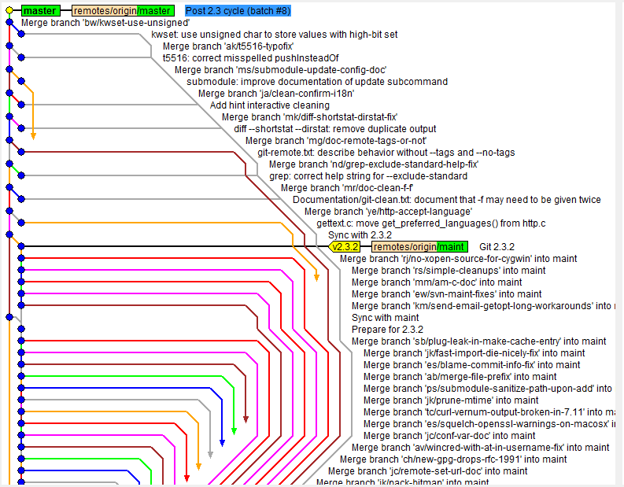
Keep Your Pace
BAD
Commit and Push GIT as frequent as possible (One commit per day)
Use GIT Flow
Fork only from release branch
Do not populate commits and push at once

Slide 20

Resources
https://www.w3schools.com
Head first books
https://projects.spring.io/spring-boot/
Vue.js resources, vuex
Join Communities
https://t.me/JVMUserGroup
https://www.meetup.com/JakartaJS/
Use your mentors
They are best people from Blibli
Again.. Use them

Slide 21
Scoring Parameters
Judges
Ketuntasan - Berapa persen dari hasil akhir?
Arsitektur (FE & BE) - Seberapa baik hasil pengerjaannya dari sisi struktur project
Unit Test & Best Practice
Dokumentasi (Ada?)
Presentasi (apakah dapat mengantarkan hasil project dengan baik)
Pemahaman Teknis
Mengerjakan peran & kolaborasi
Kerapihan
Mentors

Slide 22
Q&A
Each member Must Submit Regular Report to mentor and cc to me and Kak Aldi and mentor for technical progress. Twice a week.
Submit PR and short progress.
Maintain code quality, write carefully
Take good notice on scalability, race condition, security, code quality metrics, and other non functional parameters.
Again, communicate well with mentors, avoid assumptions

Slide 23
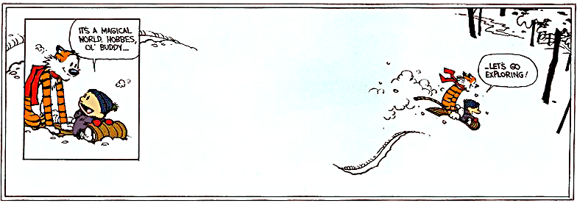
Questions?
Have fun, and explore!

